Slide 1
Numbers & Indices
Gayan Perera,
Pabasara Athukorala

Slide 2
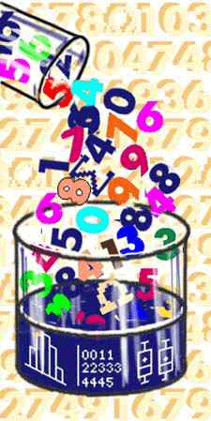
Outline
Real Numbers
Rational Numbers
Irrational Numbers
Integers
Natural Numbers
Prime Numbers
Rules of Indices

Slide 3
Types of Numbers

Slide 4
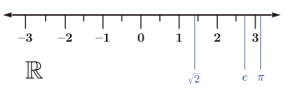

Real Numbers ($ℝ$)
In Mathematics a real number is a value that represents a quantity along a continuous line.
The Symbol of the set of real numbers is denoted by: ℝ
Positive or negative, large or small, whole numbers or decimal numbers are all Real Numbers.

Slide 5
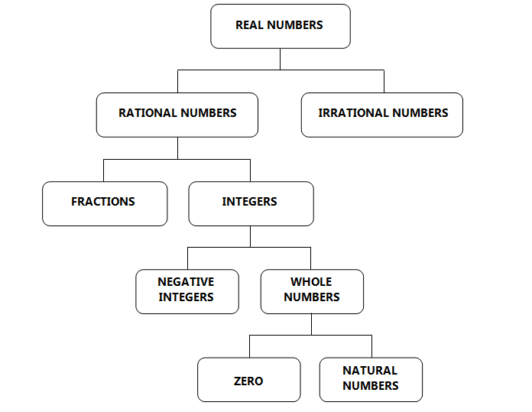
Types of Real Numbers (ℝ)
There are many types of Real Numbers
Here are some of them
Natural numbers
Whole numbers
Integers
Fractions
Rational numbers
Irrational numbers

Slide 6
Real Numbers
There are two kinds of real numbers:
Real Numbers
Rational Numbers
Irrational Numbers

Slide 7
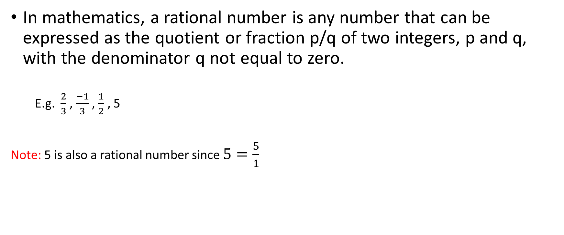
Rational Numbers (ℚ )
In mathematics, a rational number is any number that can be expressed as the quotient or fraction p/q of two integers, p and q, with the denominator q not equal to zero.
E.g. $\frac{2}{3}$ , $\frac{−1}{3}$ , $\frac{1}{2}$ , 5
Note: 5 is also a rational number since $5=\frac{5}{1}$
Rational Numbers
Fractions
Integers

Slide 8

Rational Numbers-Fractions
We call the top number the Numerator.
We call the bottom number the Denominator.

Slide 9
Rational Numbers-Integers (ℤ)
Set of numbers that consists of positive and negative whole numbers including zero is called Integers.
Integers are denoted by (ℤ)
We can write them as ℤ = {..., -3, -2, -1, 0, 1, 2, 3, ...}
Examples of integers: -16, -3, 0, 1, 198
Notes:
Check the place of the slide?

Slide 10
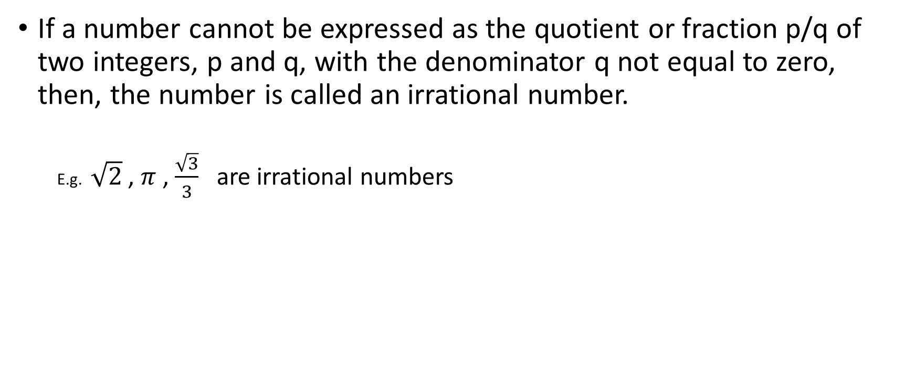
Irrational Numbers
If a number cannot be expressed as the quotient or fraction p/q of two integers, p and q, with the denominator q not equal to zero, then, the number is called an irrational number.
E.g. $\sqrt{2}$ , $π$ , $\frac{\sqrt{3}}{3}$ are irrational numbers

Slide 11
Different Types of Decimal Numbers
Terminating Decimals
3/4 = 0.75
Non terminating -Recurring decimals
2/3 = 0.666...
Rational Number
Non terminating-Non recurring decimal
√2 = 1.414...
Irrational Number
Rational Number

Slide 12
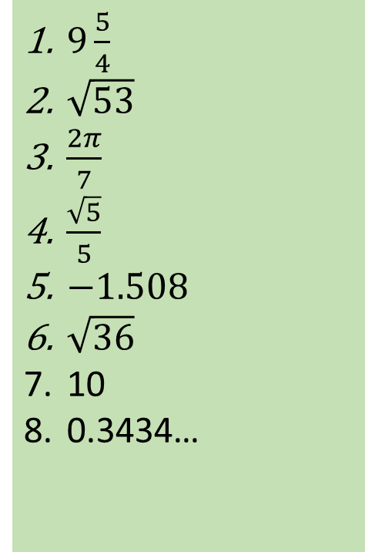

Questions
Q1) Identify which of the following are rational / irrational numbers.
2
5
0.333…
0.666
0.125
$\sqrt{5}$
$2\sqrt{3}$
$\frac{\sqrt{64}}{\sqrt{169}}$
$9\frac{5}{4}$
$\sqrt{53}$
$\frac{2π}{7}$
$\frac{\sqrt{5}}{5}$
$−1.508$
$\sqrt{36}$
10
0.3434…

Slide 13
Integers
Integers
Negative Integers
Whole Numbers
Zero
Natural Numbers

Slide 14
Natural Numbers and Whole Numbers
Positive integers excluding zero are called “Natural Numbers”.
Includes:
• the counting numbers {1, 2, 3, 4 ...}
Positive integers including zero are called “Whole Numbers”.
Includes: • numbers {0, 1, 2, 3, 4 ...}

Slide 15
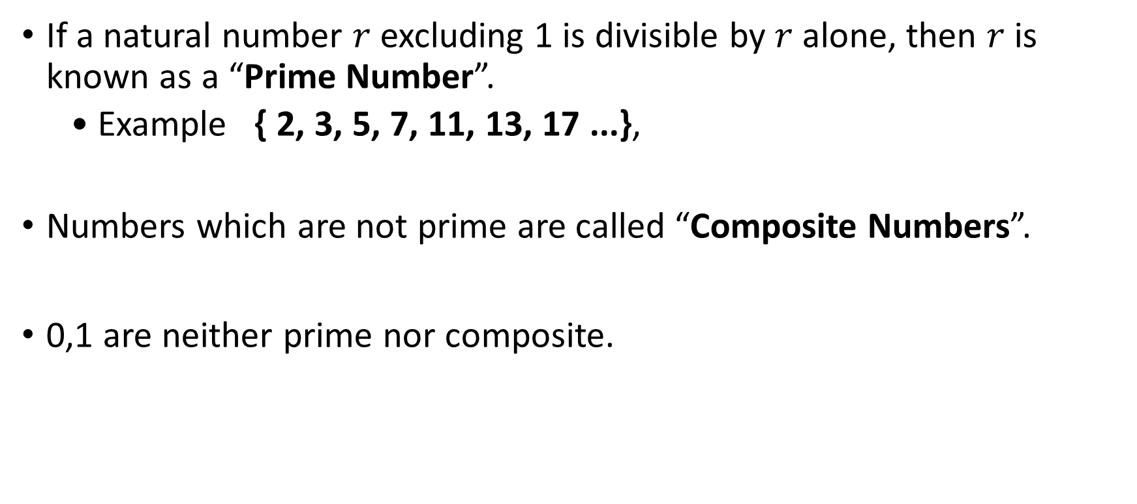
Prime Numbers
If a natural number $r$ excluding 1 is divisible by $r$ alone, then $r$ is known as a “Prime Number”.
• Example { 2, 3, 5, 7, 11, 13, 17 ...},
Numbers which are not prime are called “Composite Numbers”.
0,1 are neither prime nor composite.

Slide 16
Questions
Q2) Find all the prime numbers less than 50.
Q3) Apart from 2 are there any even-numbers that could be treated as Prime Numbers?

Slide 17
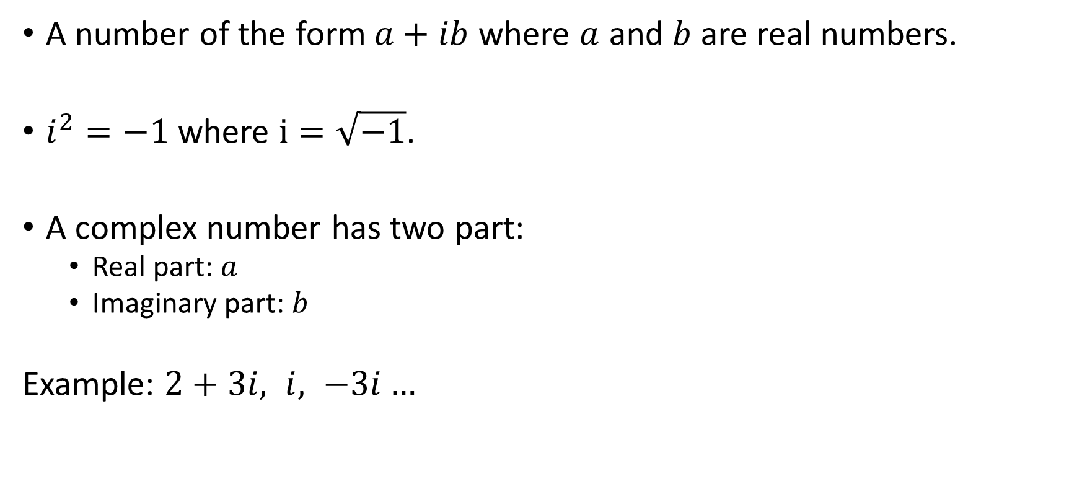

Complex Numbers ($ℂ)$
A number of the form $a+ib$ where $a$ and $b$ are real numbers.
$i^{2}=−1$ where $i=\sqrt{−1}$.
A complex number has two part:
Real part: $a$
Imaginary part: $b$
Example: $2+3i, i, −3i…$

Slide 18
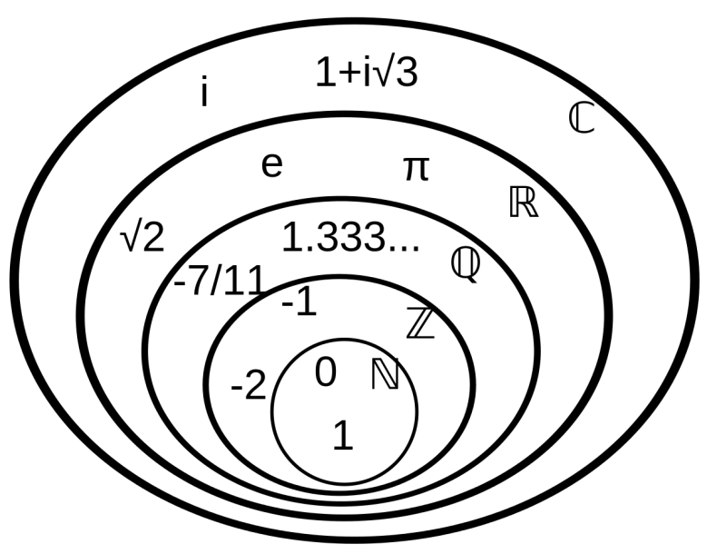
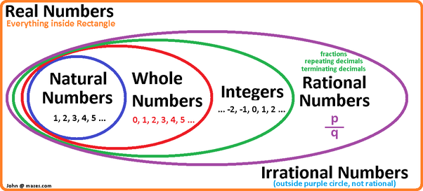
Different Number Sets
Real Numbers
(Everything inside the orange box)
Notes:
i=$\sqrt{−1}$

Slide 19
Rules of Indices

Slide 20
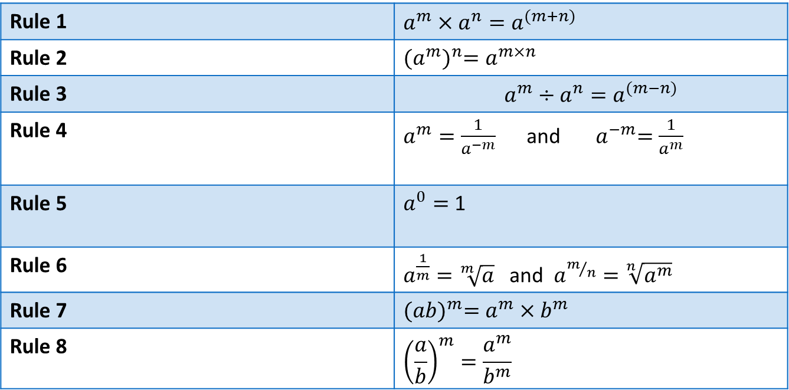
Rules of Indices
Indices are a useful way of more simply expressing large numbers.
To manipulate expressions, we can consider using the following Laws of Indices.
Rule 1 | $$a^{m}×a^{n}=a^{(m+n)}$$
Rule 2 | $${(a^{m})}^{n}=a^{m×n}$$
Rule 3 | $$a^{m}÷a^{n}=a^{(m−n)}$$
Rule 4 | $a^{m}=\frac{1}{a^{−m}}$ and ${ a}^{−m}=\frac{1}{a^{m}}$
Rule 5 | $a^{0}=$ 1
Rule 6 | $a^{\frac{1}{m}}=\sqrt[m]{a}$ and $a^{m/n}=\sqrt[n]{a^{m}}$
Rule 7 | $${(ab)}^{m}=a^{m}×b^{m}$$
Rule 8 | $${\left(\frac{a}{b}\right)}^{m}=\frac{a^{m}}{b^{m}}$$

Slide 21
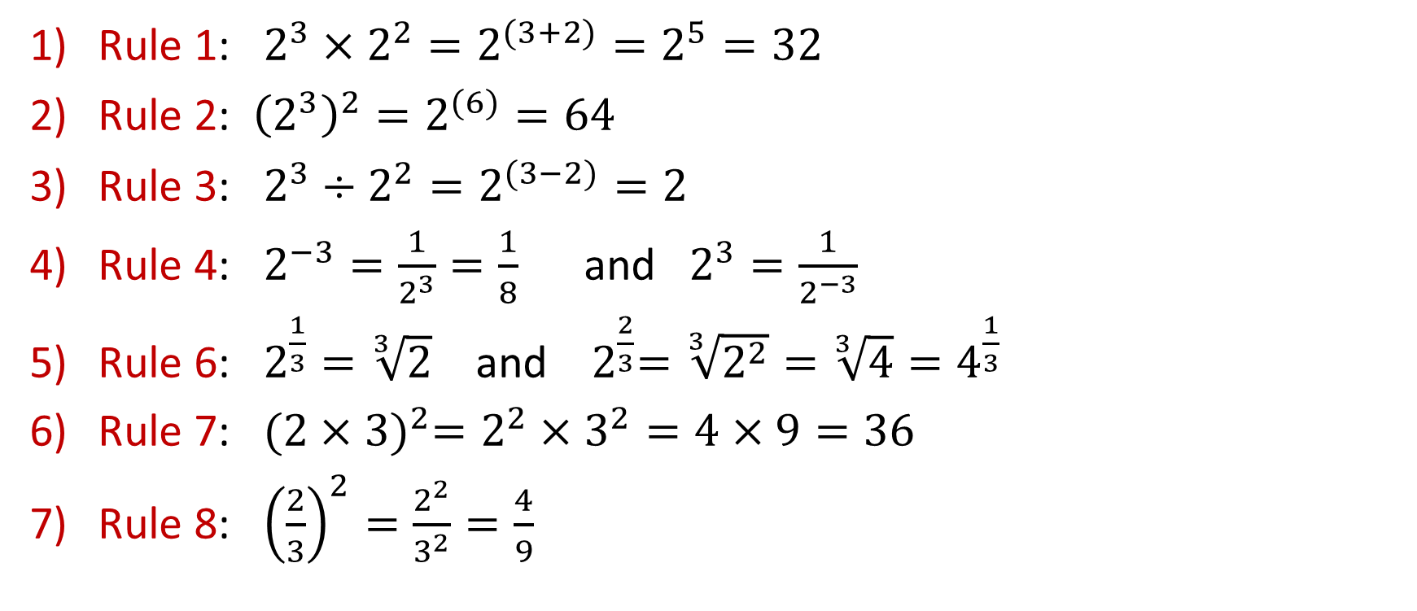
Examples
Rule 1: $2^{3}×2^{2}=2^{(3+2)}=2^{5}=32$
Rule 2: ${\left(2^{3}\right)}^{2}=2^{(6)}=64$
Rule 3: $2^{3}÷2^{2}=2^{(3−2)}=2$
Rule 4: $2^{−3}=\frac{1}{2^{3}}=\frac{1}{8}$ and $2^{3}=\frac{1}{2^{−3}}$
Rule 6: $2^{\frac{1}{3}}=\sqrt[3]{2}$ and ${ 2}^{\frac{2}{3}}=\sqrt[3]{2^{2}}=\sqrt[3]{4}=4^{\frac{1}{3}}$
Rule 7: ${(2×3)}^{2}=2^{2}×3^{2}=4×9=36$
Rule 8: ${\left(\frac{2}{3}\right)}^{2}=\frac{2^{2}}{3^{2}}=\frac{4}{9}$

Slide 22

Answer the following questions
Q1) Find the simplified form of the following. Each expression should have positive exponents.
${(p^{5})}^{4}$
${(p^{4})}^{5}$
${(p^{−5})}^{4}$
${y^{3}(y^{−5})}^{2}$
${(4m)}^{3}$
$\frac{1}{y^{−4}}$
${(2x^{3}y^{−3})}^{−2}$

Slide 23
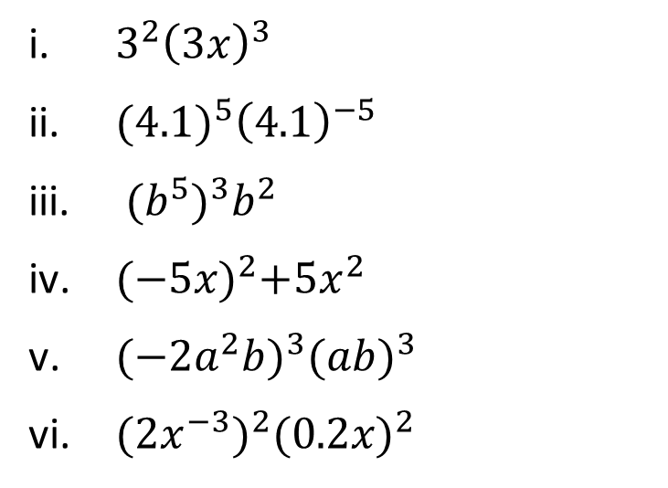
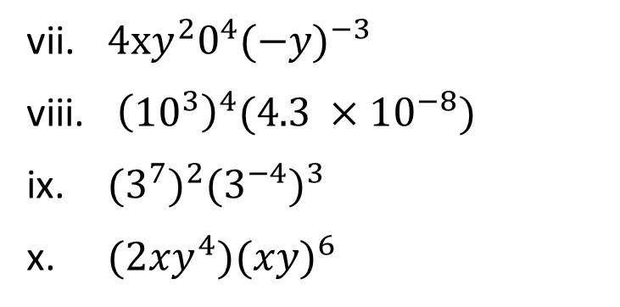
Questions
Q2) Simplify each expression.
${3^{2}\left(3x\right)}^{3}$
${{(4.1)}^{5}\left(4.1\right)}^{−5}$
${(b^{5})}^{3}b^{2}$
${{(−5x)}^{2}+5x}^{2}$
$(−2{a^{2}b)}^{3}{(ab)}^{3}$
$(2{x^{−3})}^{2}{(0.2x)}^{2}$
$4xy^{2}0^{4}{(−y)}^{−3}$
${\left({10}^{3}\right)}^{4}(4.3 ×{10}^{−8})$
${{(3}^{7})}^{2}{{(3}^{−4})}^{3}$
$(2xy^{4}){(xy)}^{6}$

Slide 24


Questions
Q3) Complete each equation.
${\left(b^{2}\right)}^{\text{}}{=b}^{8}$
${\left(m^{\text{}}\right)}^{3}{=m}^{−12}$
${\left(x^{\text{}}\right)}^{7}{=x}^{6}$
${\left(n^{9}\right)}^{\text{}}=1$
${\left(y^{−4}\right)}^{\text{}}{=y}^{12}$
${7\left(c^{1}\right)}^{\text{}}{=7c}^{8}$
${\left({5x}^{\text{}}\right)}^{\text{2}}{=25x}^{−4}$
${\left(3x^{3}y^{\text{}}\right)}^{\text{3}}{=27x}^{9}$
${\left(m^{2}n^{3}\right)}^{\text{}}=\frac{1}{m^{6}n^{9}}$
$\frac{a b^{2}}{a^{2}b}=\frac{a}{b^{2}}$

Slide 25


Questions
Q4) Solve each equation. Use the fact that if $a^{x}$=$a^{y}$ then $x=y.$
$5^{x}={25}^{x}$
${3^{x}=27}^{4}$
$8^{2}=2^{x}$
${4^{x}=2}^{6}$
$3^{2x}=9^{4}$
$2^{x}=\frac{1}{32}$
${(27)}^{2/3}=3^{x}$

Slide 26

Questions
Q5) What is the simplified form of each expression?
$\frac{y^{5}}{y^{4}}$
$\frac{d^{3}}{d^{9}}$
$\frac{{k^{6}j}^{2}}{{kj}^{5}}$
$\frac{{a^{−3}b}^{7}}{{a^{5}b}^{2}}$
$\frac{{x^{4}y}^{−1}z^{8}}{{{zx}^{4}y}^{5}}$

Slide 27
Thank You !

